Slide 1

Various type of existing Air launched system
Indian Institute of Technology Kanpur
Guide: Prof. Abhishek
Presented by: Sujeet Kumar (211067)

Slide 2
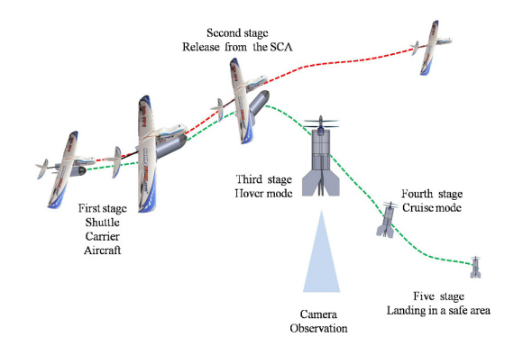
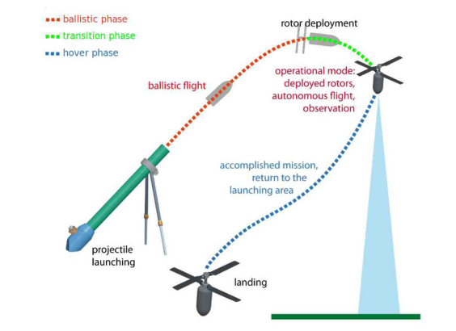
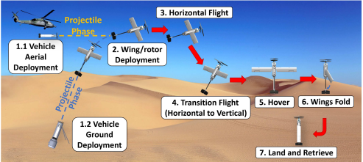
Types of Air launched UAVs
HELICOPTER LAB
Air launched UAV can be classified on the basis of:
Launch method
Vehicle configuration type

Slide 3

Air Launched Tail sitter
HELICOPTER LAB
Mainly being used for ISR (intelligence, surveillance, reconnaissance) Missions
Lunched ballistically and the uses fixed wing flight for reaching its target and then Hover over target.

Slide 4
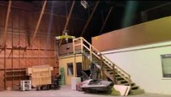
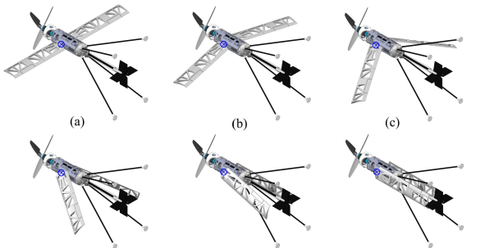
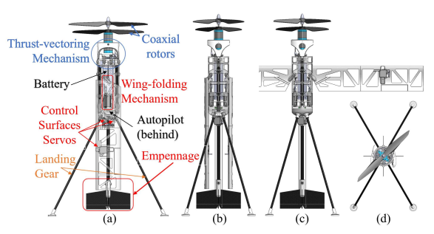
Weight = 946 g
Wingspan = 0.765 m (30.1 in)
Chord = 0.08 m (3.15 in)
AR = 9.6
Wing Area = 0.0612 m2
Airfoil = S1223
Design Cruise Speed =16.8 m/s

Slide 5
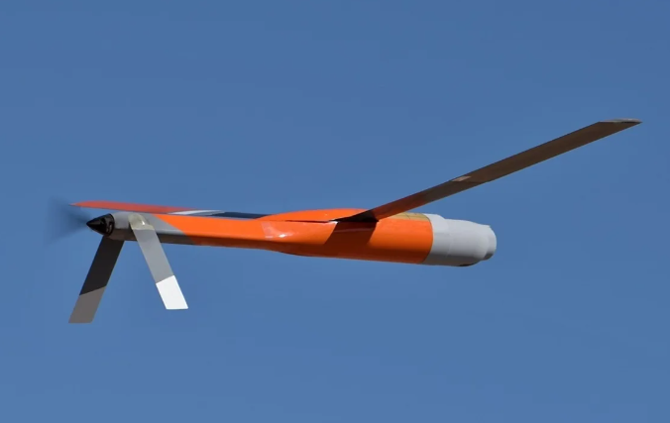
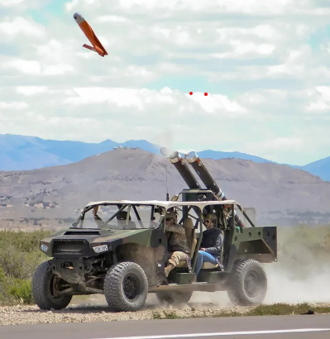
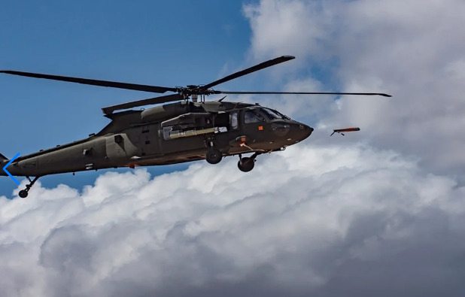
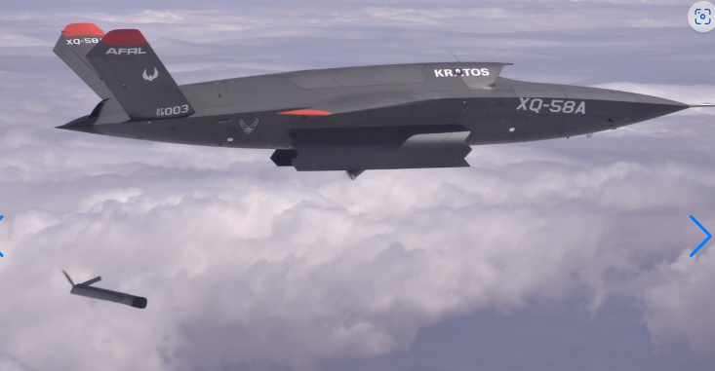
ALTIUS-600 (Area-I us company)
HELICOPTER LAB
Part of ALTIUS (air-launched, tube-integrated, unmanned system) family

Slide 6
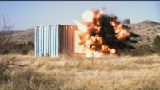
Specifications: Range : 90 Km Gross weight:: 12.25 Kg cruise speed: 60 km/h Speed: 90 km/h(max) Launch method: Tube launched Variants:- ALTIUS-700, ALTIUS-900

Slide 7
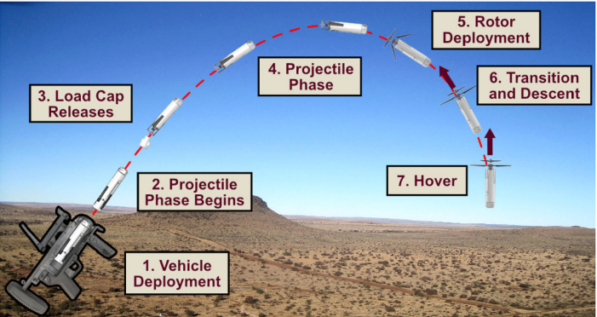
Gun Launched MAV Concept
HELICOPTER LAB
Mainly being used for ISR (intelligence, surveillance, reconnaissance) Missions
Can be launched from 40 mm Grenade launcher
Projectile phase of flight allows for saving the stored energy until vehicle reaches designated operating location.
Can focus on a single target for an extended duration or navigate in confined spaces

Slide 8
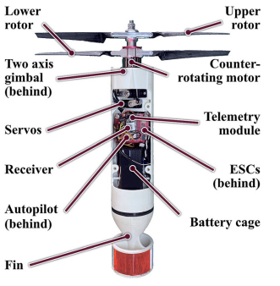
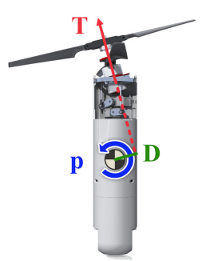
Endurance <20 Min
Weight = 366 g
Rolling/pitching moment created by the thrust-vectoring mechanism

Slide 9
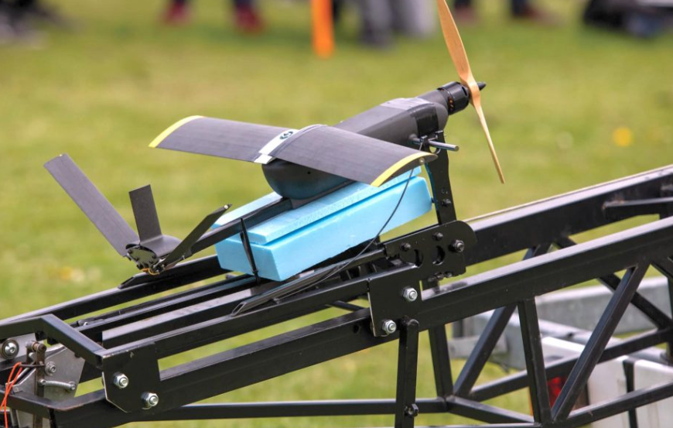
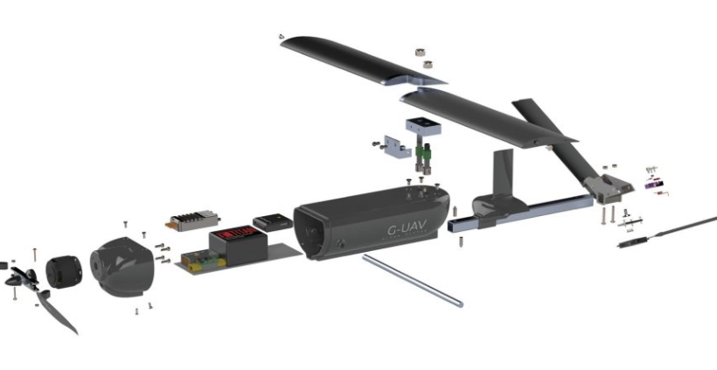
G – UAV( DS5, University of Southampton)
HELICOPTER LAB
Designed to launch from G Type sonobuoy
Parachute assisted launch, Use case can be SIR missions and Maritime missions.
Overall weight of UAV is 2 kg

Slide 10
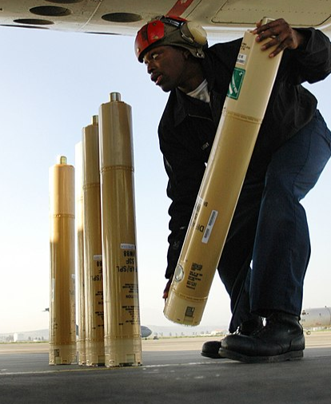
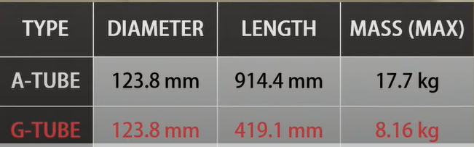
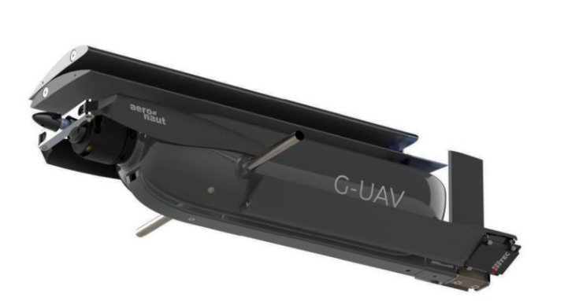
Types of sonobuoy

Slide 11
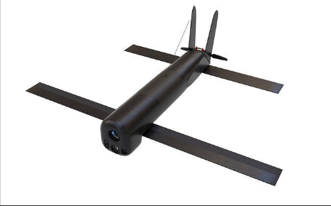
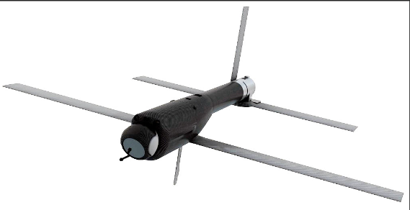
AeroVironment Switchblade
HELICOPTER LAB
A miniature loitering munition
Switchblade launches from a tube, flies to the target area, and crashes into its target while detonating its explosive warhead
Two variants of this vehicle

Slide 12
 | Switchblade 300 | Switchblade 600
Mass | 2.5 kg | 15 Kg
Length | 19.5 in | 51 in
Diameter | 3 in | 6 in
Range & Endurance | 10 Km / 15 min | 40 km / 40 min
Altitude | < 150m | < 150 m
Maximum Speed | 101-160 km/h | 113-185 km/h
Guidance system | Autonomous, manual | Autonomous, Manual
Launch Platform | Tube Launched, Multipack | Tube Launched, Multipack

Slide 13
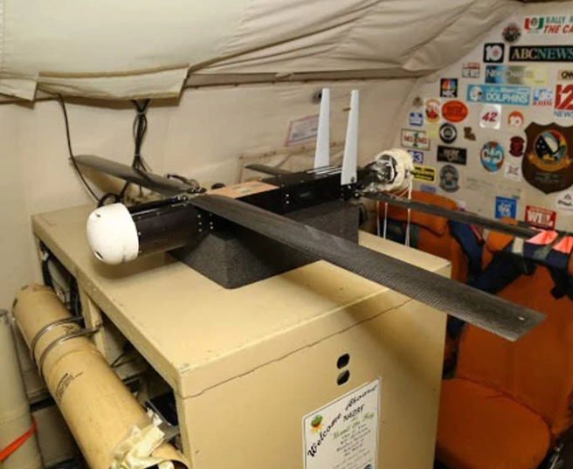
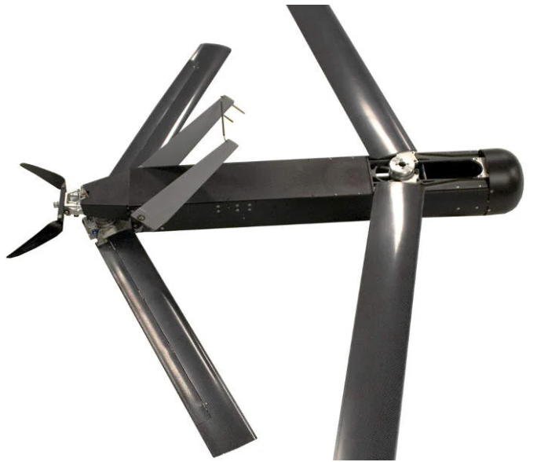
Raytheon Coyote
HELICOPTER LAB
A miniature expendable loitering munition
Switchblade launches from a tube, flies to the target area, and crashes into its target while detonating its explosive warhead
Can be launched from sonobuoy

Slide 14
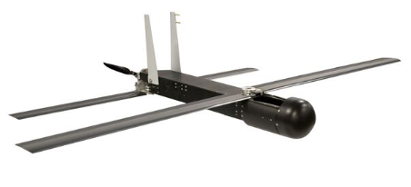
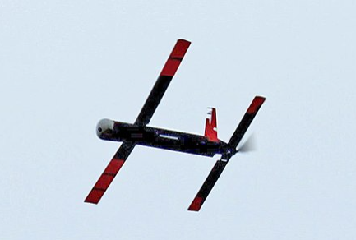
Airspeed | 102-130 km/h
Altitude | 9.1km
Comms Range | Up to 130 km
Endurance | 1 hr +
Weight | 5.9 kg
Length | 0.91m
Wingspan | 1.2 m

Slide 15
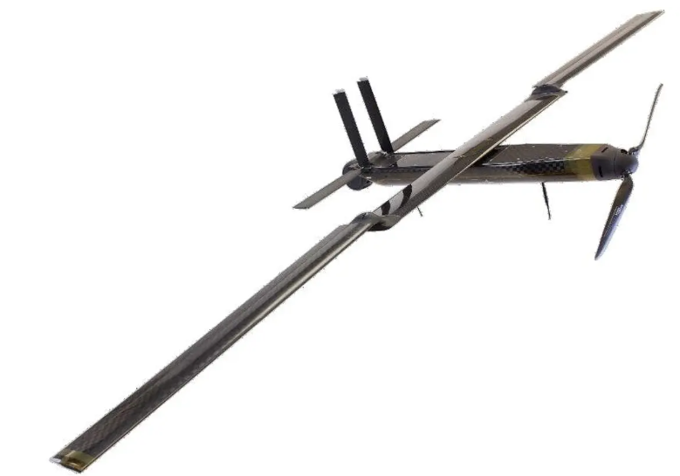
Lockheed OUTRIDER
HELICOPTER LAB
Canister Launched Unmanned aircraft system
Developed for ISR Missions
Weight | 1.7 Kg
Dash speed | 25 m/s
Endurance | 120 min
Launch Method | Canister Based

Slide 16
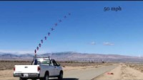
SQUID (Streamlined Quick Unfolding Investigation Drone)
HELICOPTER LAB
Used for ISR (intelligence, surveillance, reconnaissance) Missions
Cannon launched.

Slide 17
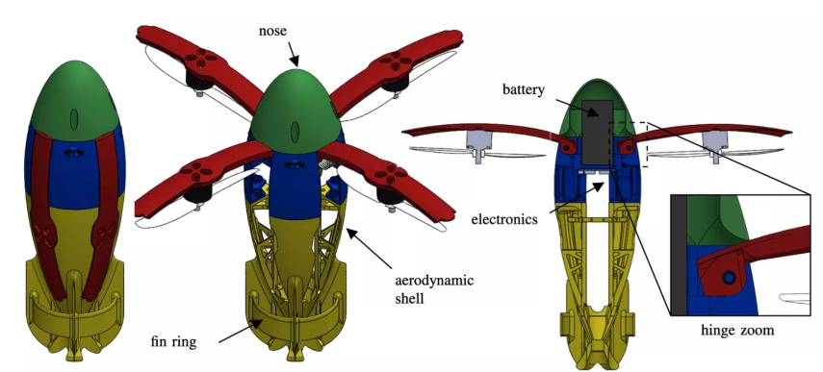
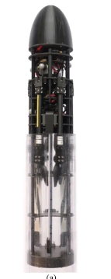
Weight | 530 g
Diameter | 8 cm
Length | 27 cm
Tube Dia | 15 cm
SQUID partially inside the launcher tube

Slide 18
Hero Series UAS
HELICOPTER LAB
Name | Hero 30 | Hero 90 | Hero 120 | Hero 400 | Hero 900 | Hero 1250
Flight Endurance | 30min | 45min | 60min | 120 min | 6hr | 10hr
Range (km) | 15+ | 40 | 60 | 120 | 150+ | 200+
Warhead Type | 0.5kg | 1.5(MP) | 4.5(MP) | 10 | M.P | 50(MP)
Weight (kg) | 3.5 | 9 | 18 | 50 | 110 | 155
Man-Portable (Back Packed) | YES | YES | YES | NO | NO | NO
Typical Operating Altitude (AGL) | NA | NA | NA | NA | 2000-3500 | 2500-3500
Power | NA | NA | NA | Battery | Diesel/Hybrid | Diesel/Hybrid
Camera (for ISR, Tracking and attacking) | YES | YES | YES | YES | YES | 3 Gimbal (EO/IR)
Launch Method | Tube, sea launched | Tube, Heli, Sea | Tube, Heli, sea | Rail, Tube,Heli,sea | Rail, Tube | Rail, Tube

Slide 19
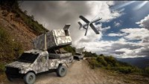
Launch Platforms and compatible systems
Ground launcher | Hero 30, Hero 90, Hero 120, Hero 400, Hero 900, Hero 1250
Helicopter launched | Hero 90, Hero 120, Hero 400
Sea Launched | Hero 30, Hero 90, Hero 120, Hero 400

Slide 20
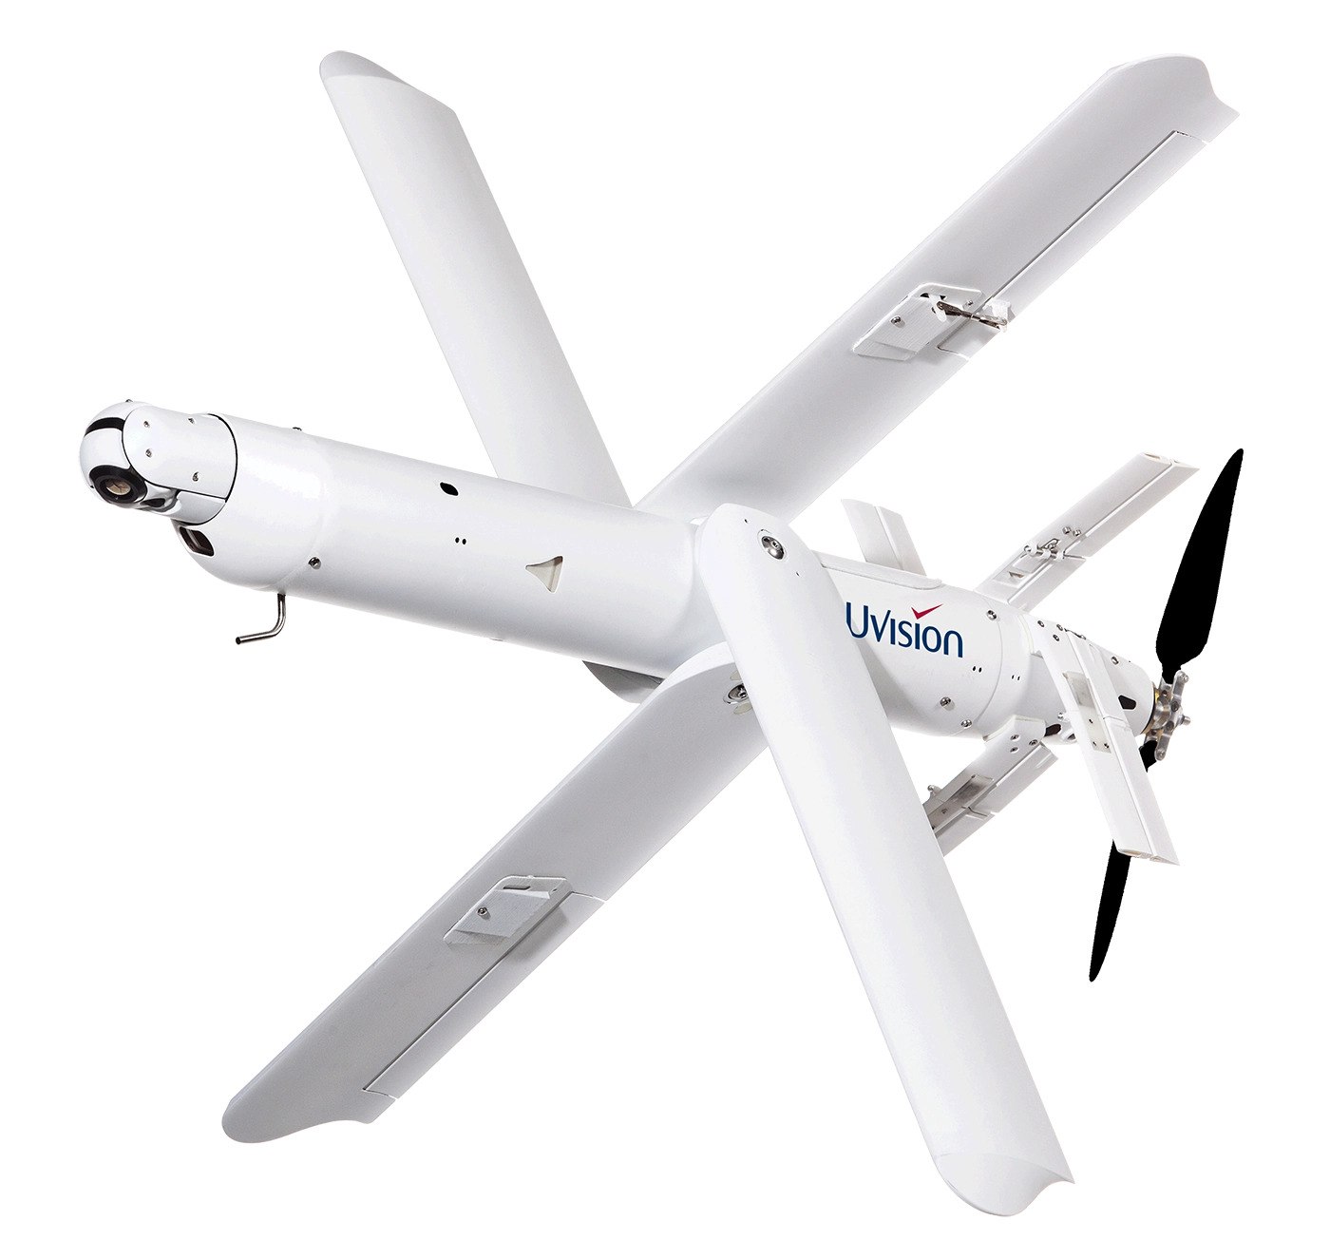
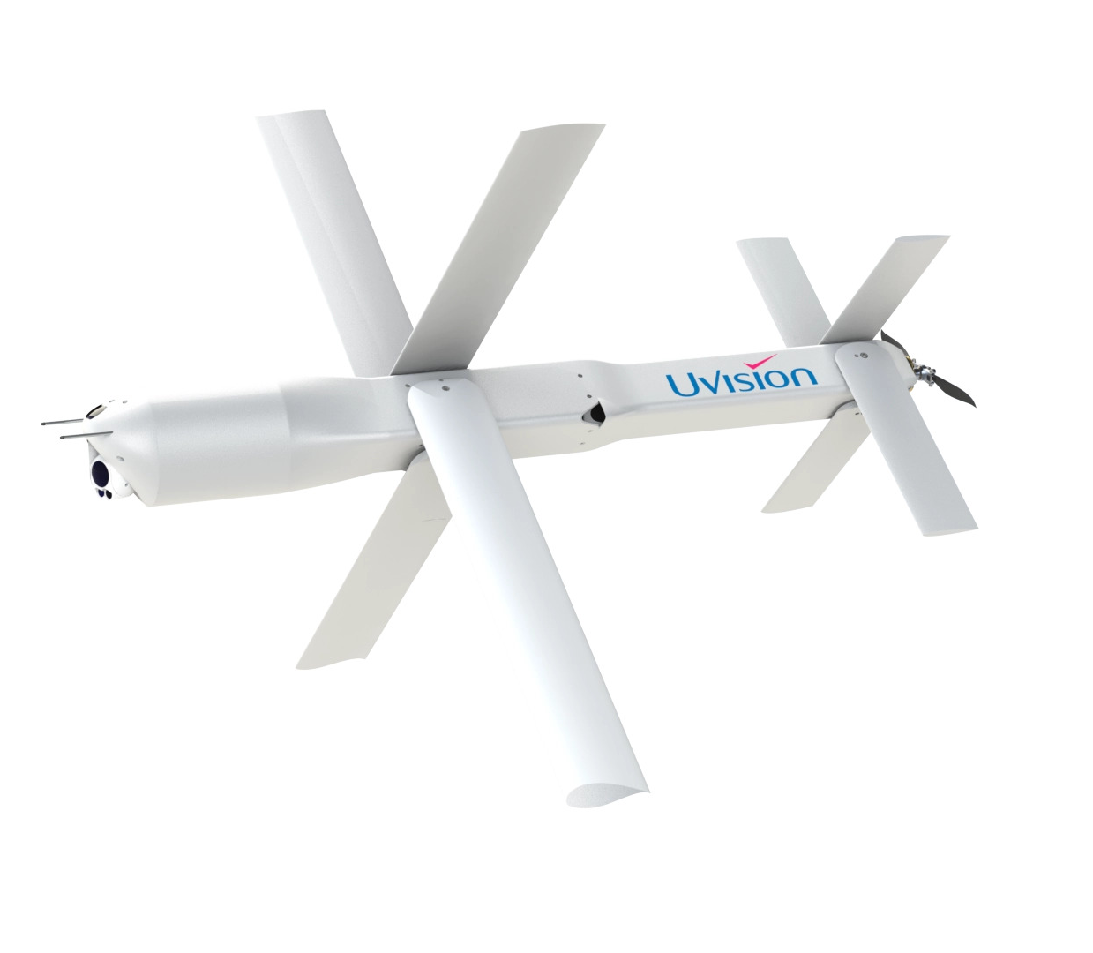
Hero 30
Hero 90

Slide 21
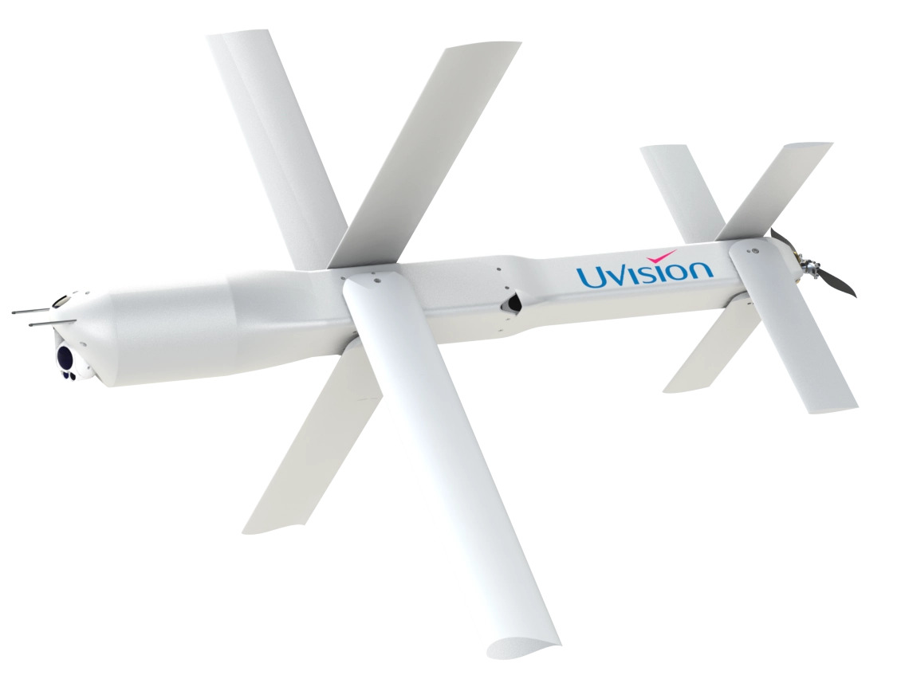
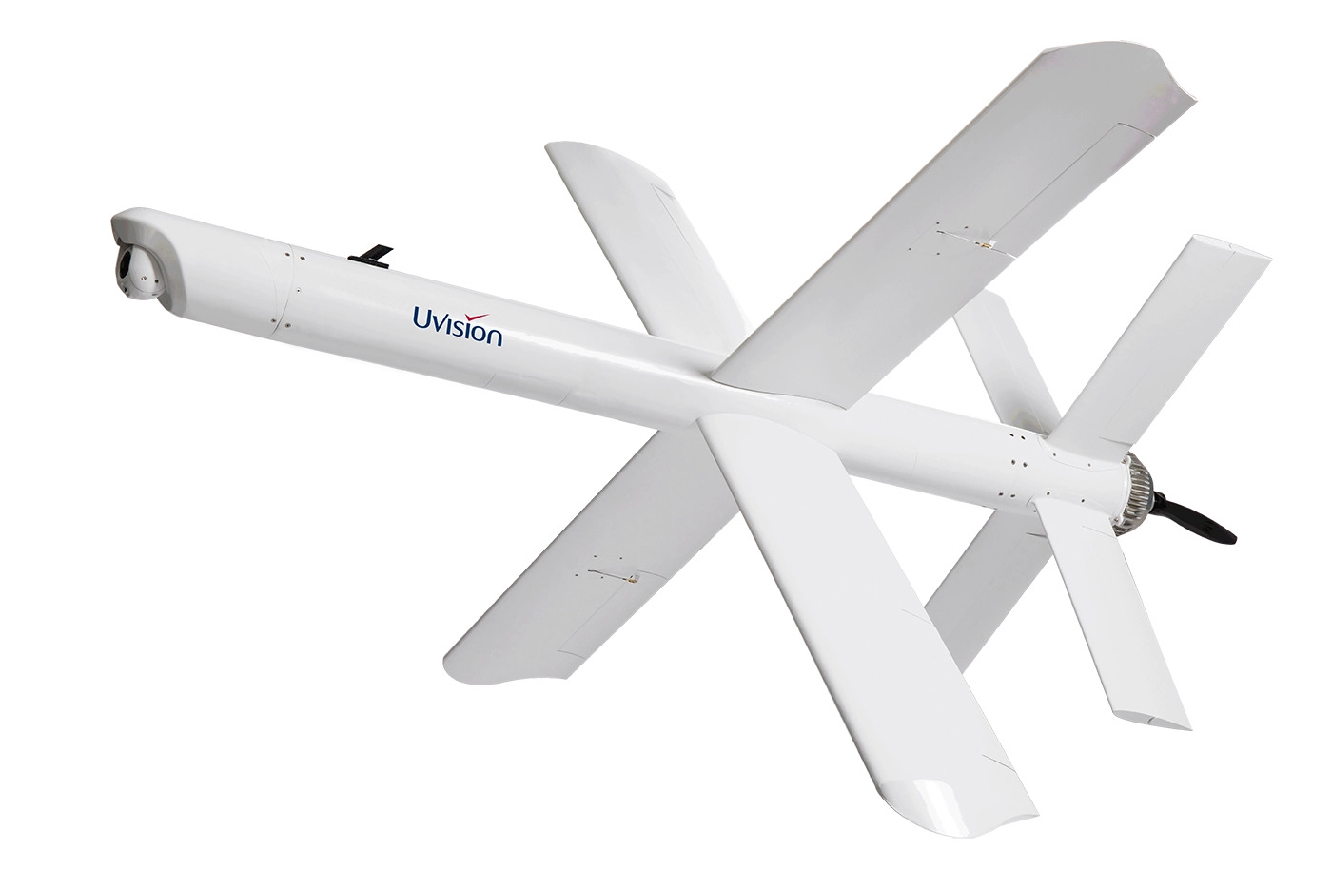
Hero 120
Hero 400

Slide 22
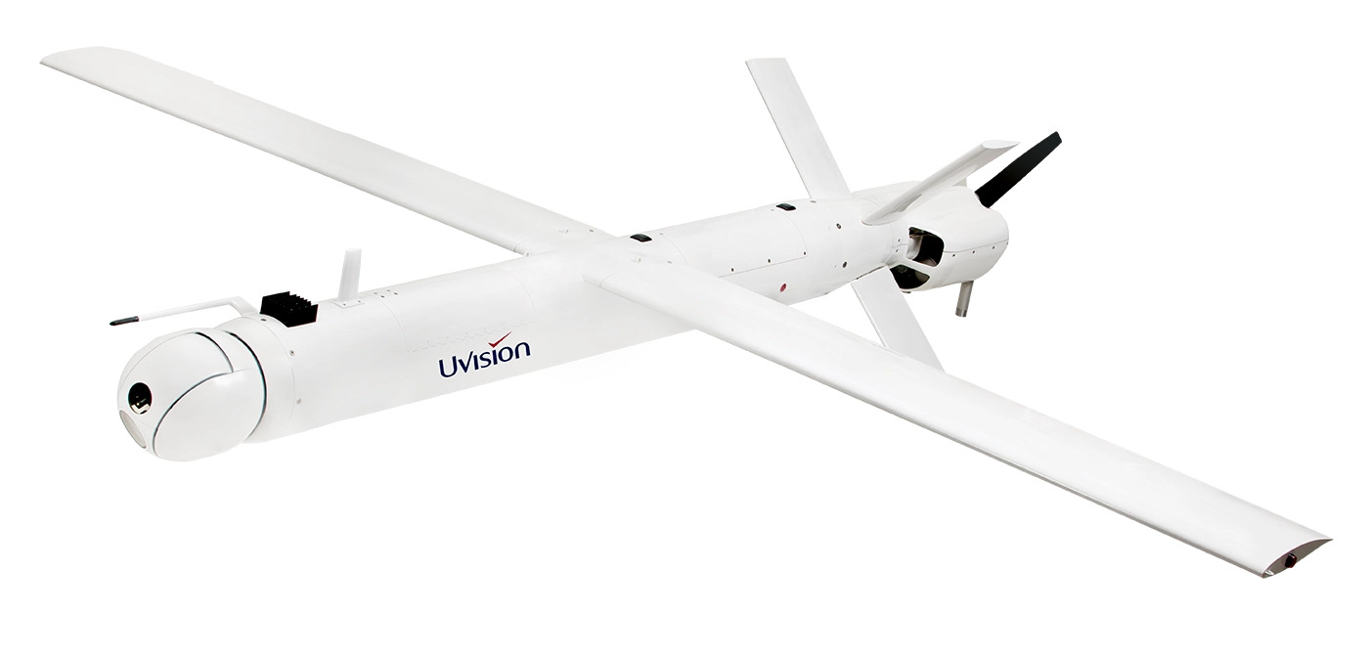
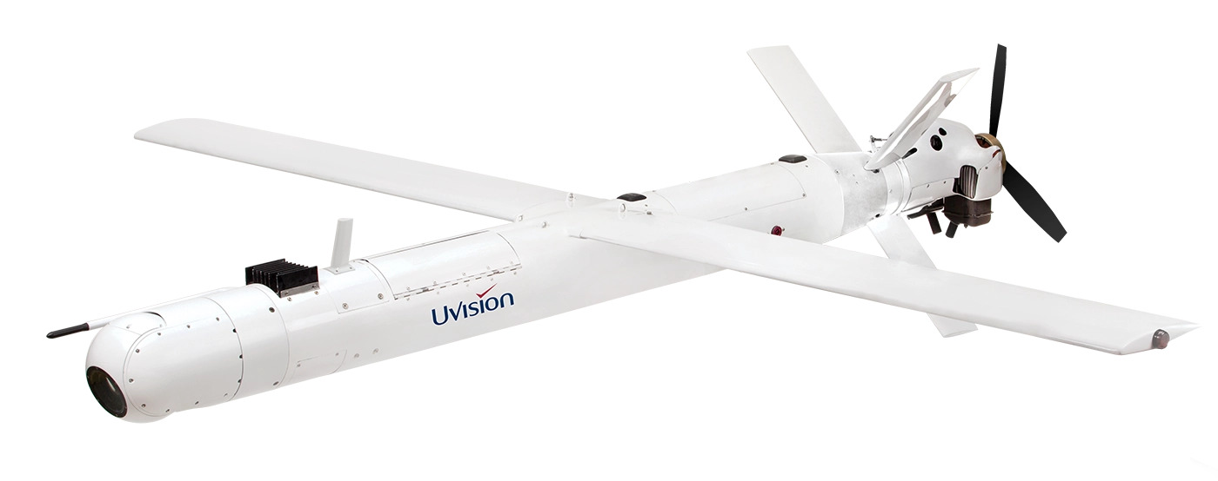
Hero 900
Hero 1250

Slide 23
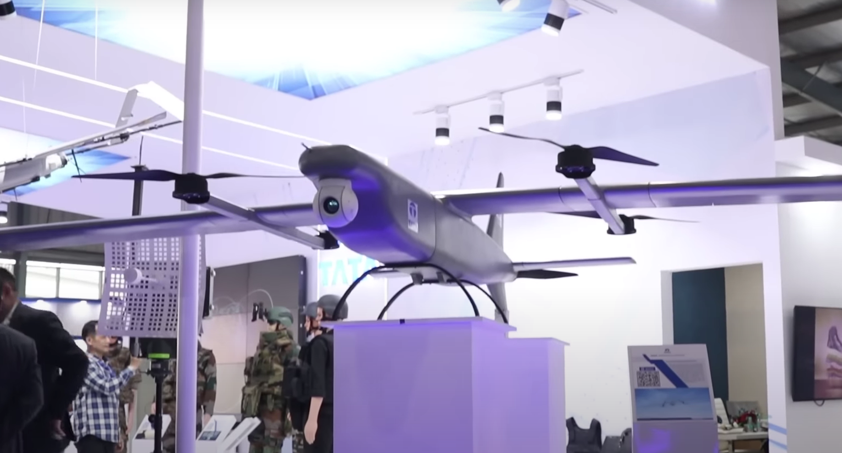
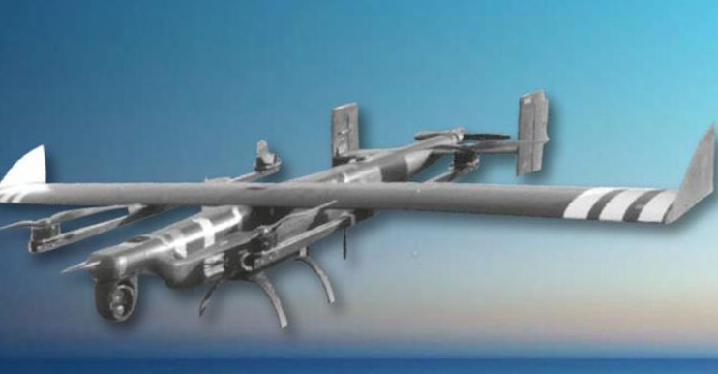
Tata ALS 50
HELICOPTER LAB
The ALS-50 is an advanced weapon system with unique VTOL capability, adaptability, and versatility to engage air, ground, and naval targets
It is 2.5 m long with wingspan of 3.8 m, can carry 6 kg payload upto 50 km at 100 km/h.

Slide 24
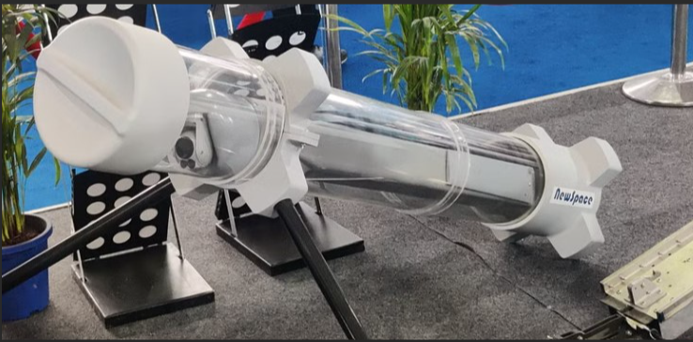
ALPHA-S loitering Munition
HELICOPTER LAB
Designed and Developed by NewSpace Research and Technologies
Developed for ISR and as a Loitering munition UAV
Launches from a tube, flies to the target area, and crashes into its target while detonating its explosive warhead.
Specifications
Weight | 7 kg
Range & Endurance | 30 km/50 min
Operational Speed | 70-80 kmph
Max Speed | 120-150 kmph(claimed)
Claimed Launch platforms | Fighter jet/Helicopter Tube launched

Slide 25
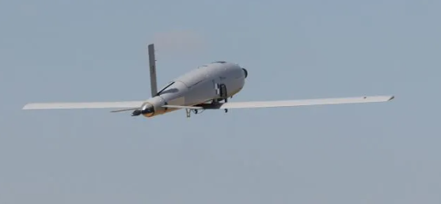
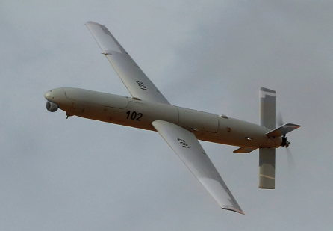
Sky Striker(Elbit systems product)
HELICOPTER LAB
Designed and Developed by Elbit systems and has been sold to Indian army under the JV with Alpha design Technologies.
Developed for ISTAR (Intelligence, surveillance, Target acquisition, and reconnaissance) missions.
Uses pneumatic launcher to launch, flies to the target area, and crashes into its target while detonating its explosive warhead.
Have abort, go-around, and re-engage capabilities and also comes with optional parachute assisted recovery system.

Slide 26
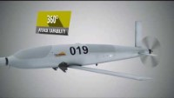
Range | Up to 100 km
Endurance | 2 hrs./5 kg and 1hrs/10 kg
Speed | 22-50 m/s
Warhead | 5-10 kg
Launch Method | Catapult launcher
Recovery Method | Parachute assisted

Slide 27
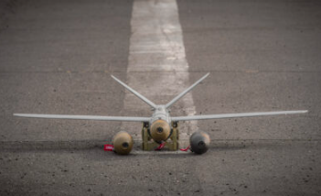
WARMATE loitering munition(WB GROUP)
HELICOPTER LAB
Sold a 100 of such system to Indian army.
Used as Reconnaissance & Strike system (ISTAR) and can be equipped with a laser-seeking Warhead.
Uses catapult launcher to launch, flies to the target area, and crashes into its target.
Parachute assisted recovery.

Slide 28
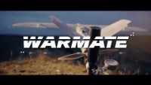
Range RLOS | 30 km
Endurance | 50 min
Speed | 22-42 m/s
MTOW/Warhead | 5.3 kg/1.4 kg
Span/ Fuselage length | 1.6 m/1.1 m
Altitude AGL | 150-3000 m
Launch/Recovery | Catapult/Parachute

Slide 29
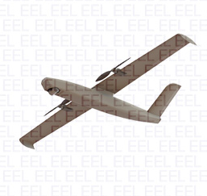
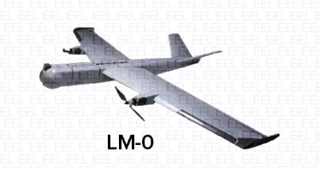
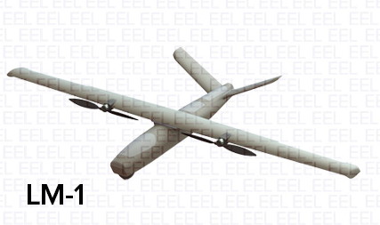

Solar Industries (Nagastra Series)
HELICOPTER LAB
Designed and Developed by Solar Industries India Limited.
Developed for ISR and as a Loitering munition UAV
There are Three Variants Namely LM-0,1,2 and These are also known as NAGASTRA series of drones.
Zee Motion Technologies(Backed by Solar group) offers LM 0 with name of TRINETRA.

Slide 30
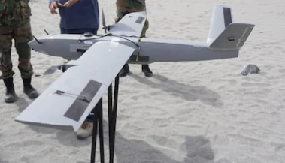
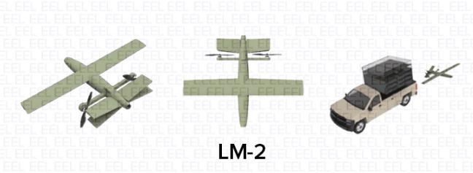
Specifications of LM(loitering Munition)
 | LM-0/TRINETRA | LM-1 | LM-2
Weight (estimates) | 5.5 kg | 10-15 kg | 25-30kg
Range/Endurance/speed | 15 km/60 min/20m/s | 25 km/60 min | 40 km/ -
Warhead | 1 kg | 4 kg | 10 kg
Launch Method | Hand Launched Method | Tube/Catapult | Vehicle Mounted Tube

Slide 31
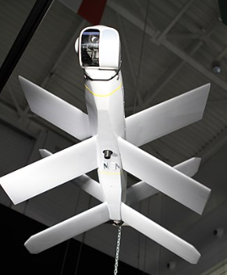

Lancet family loitering munitions
HELICOPTER LAB
Designed and developed by the Russian company Zala Group, a subdivision of the Kalashnikov Group.
The design of the Lancet-3 is based on a cylindrical fuselage with two pairs of X-shaped wings mounted at the front and rear of the fuselage.

Slide 32


 | Lancet-3 | Lancet-1
Endurance | 40 min | 30 min
MTOW/Payload | 12 kg/3 kg | 3 kg/1 kg
Speed | 80-110 kmph | ---
Lancet-1

Slide 33


CH-901 (China Aerospace Science and Technology Corporation)
HELICOPTER LAB
The CH-901 can be readied and launched from its tube in 3 minutes and can also be launched with from the new FH-97 unveiled at Airshow China in 2021.
Design looks similar to switchblade.

Slide 34
Specifications | Reconnaissance-I | Reconnaissance-II
MTOW/ payload | 3.5 kg/0.5 kg | 9 kg/1.5 kg
Diameter (when folded) | 110 mm | 140 mm
Body length | 739 mm (propellers included) | 1069 mm (propeller included)
Target positioning accuracy | 1 m (CEP) | 30 m (CEP)
Takeoff method | Canister launch (cool gas/rocket/pressure) | Canister launch (cool gas/rocket/pressure)
Recovery method | Parachute (reconnaissance version) | Parachute (reconnaissance version)
Control radius | 10 km | 10 km
Endurance | 30 min | 30 min
Cruise speed | 30 m/s to 40 m/s | 30 m/s to 40 m/s
Max flight speed | 50 m/s | 50 m/s
Minimum turning radius | -- | 100 m
Altitude | 50 m ~ 150 m | 50 m ~ 300 m

Slide 35



Spike Firefly
HELICOPTER LAB
Designed and Developed by Rafael Advance defense system LTD.
Engage enemy behind the cover and Situational Awareness.
Round Dimension 80mm x 80mm x 400mm .

Slide 36

Endurance | Single battery/including Warhead-15min Double Battery/no Warhead-30 min Deployed in STBY- 2 Hours
Range(Urban/open) | 500/1000
Velocity(Maneuvering /Dive) | 60/70 km/h
Weight/CU/MTOW/Warhead | 3/1/15 kg 350g

Slide 37

Sahed 136 (Iran)
HELICOPTER LAB
Munition designed for long-range ground attack, fired in batches to overwhelm air defenses by consuming their resources.
The launch frame and drone assembly's portability allows for easy mounting on the back of military or commercial trucks, providing flexibility in deployment.
The aircraft is launched at a slight upward angle with rocket launch assistance (RATO), utilizing an Iranian-made Mado MD-550 piston engine after the rocket is jettisoned, enabling sustained flight.
Fuselage Length/Wingspan | 3.5m/2.5m
Speed | 185 km/h
Weight | 200kg
Warhead Weight | Estimated (30–50) kg
Range | Estimated (970–1,500)km

Slide 38

Sahed 136
HELICOPTER LAB

Slide 39


My Design
HELICOPTER LAB
Wing Folded
Wing Deployed

Slide 40


My Design
HELICOPTER LAB
Isometric view
Bottom view

Slide 41
Thank You

